Slide 1
Capstone Project
The Battle of Neighborhoods
Introduction: Events/Holiday/Travel plan details to neighborhoods of Toronto.
The report will provide details of Hotels (for stay), nearby restaurants, places to visit in the vicinity, places for shopping, cafes etc.
This will help any event management firm or a family to plan for a short trip providing them vital information of the neighborhood for their place of visit.
Detailed maps will be provided for the same.
Target audience here is either an Event Management firm or a family that may need details of the neighborhood, which would help them to plan their trips accordingly.

Slide 2
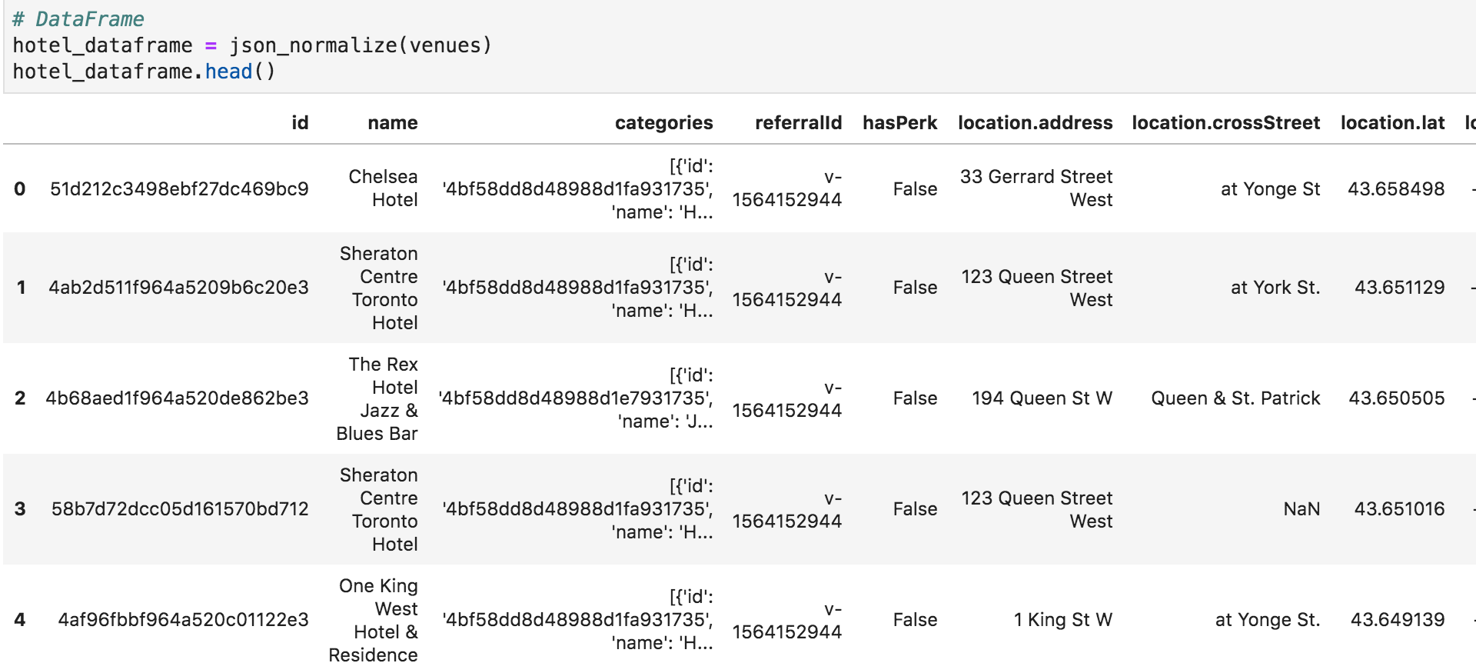
The Battle of Neighborhoods
Extracting, Filtering and Formatting the data
Three venues (Restaurants, shops and Hotels) were targeted. This would form the base of the report and help travelers plan their travel to this neighborhood.
Foursquare API was used to extract data.

Slide 3
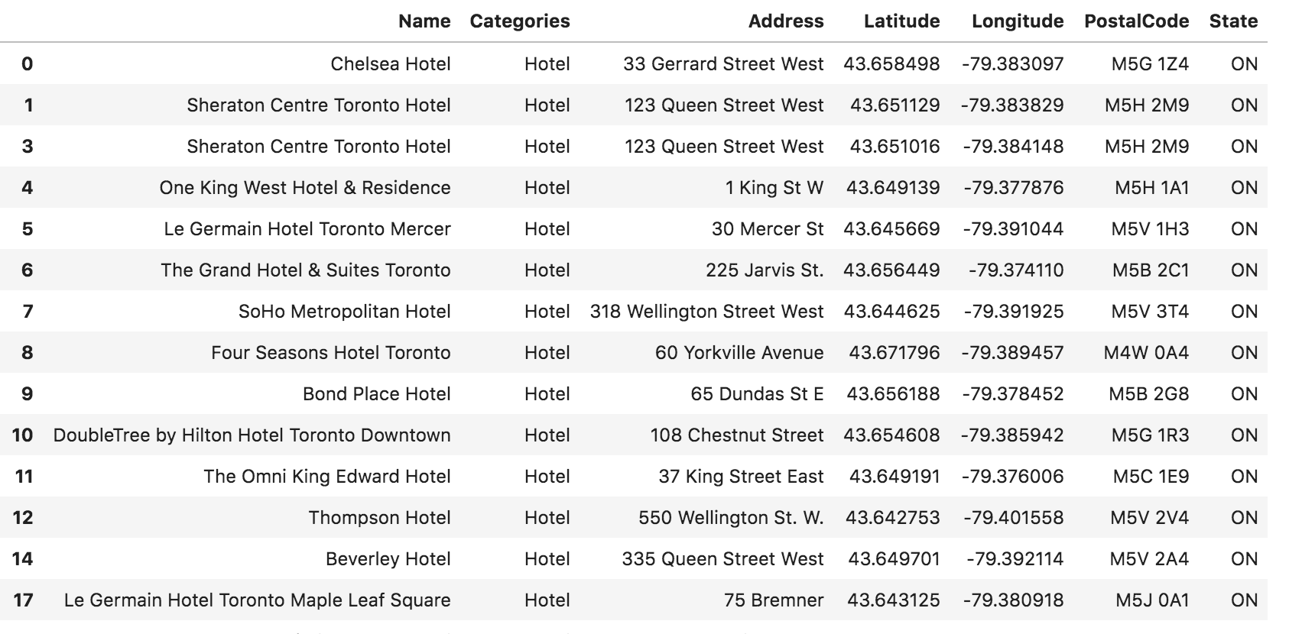
The Battle of Neighborhoods
Extracting, Filtering and Formatting the data…
The extracted data needed to be formatted to ensure we get distinct categories to filter the data from. Once the data was filtered, it was easier to format the same by removing undesired columns and grouping based on categories.

Slide 4
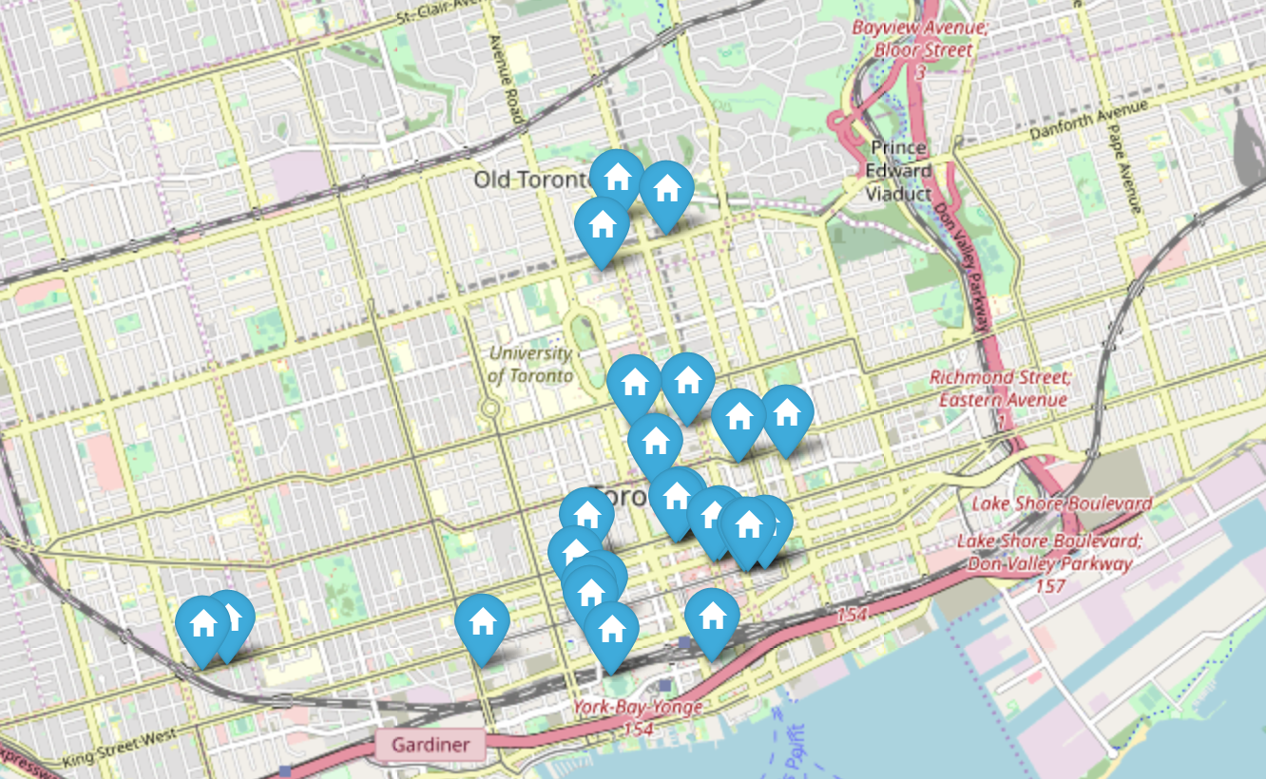
The Battle of Neighborhoods
Visualization
The formatted data would be of immense help to the travelers if it would be visualized in a map format. Using the folium API with markers and glyphicon icons, we obtained the following for Hotels.

Slide 5
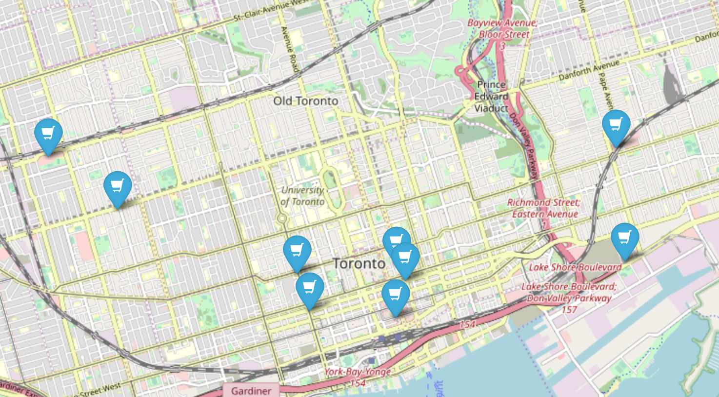
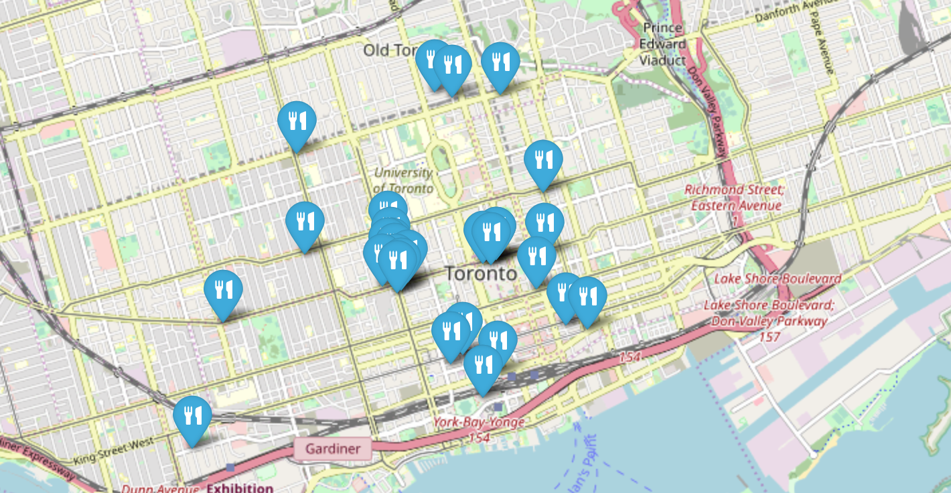
The Battle of Neighborhoods
Visualization…
Similar maps (with different icons) were created for shops and restaurants.

Slide 6
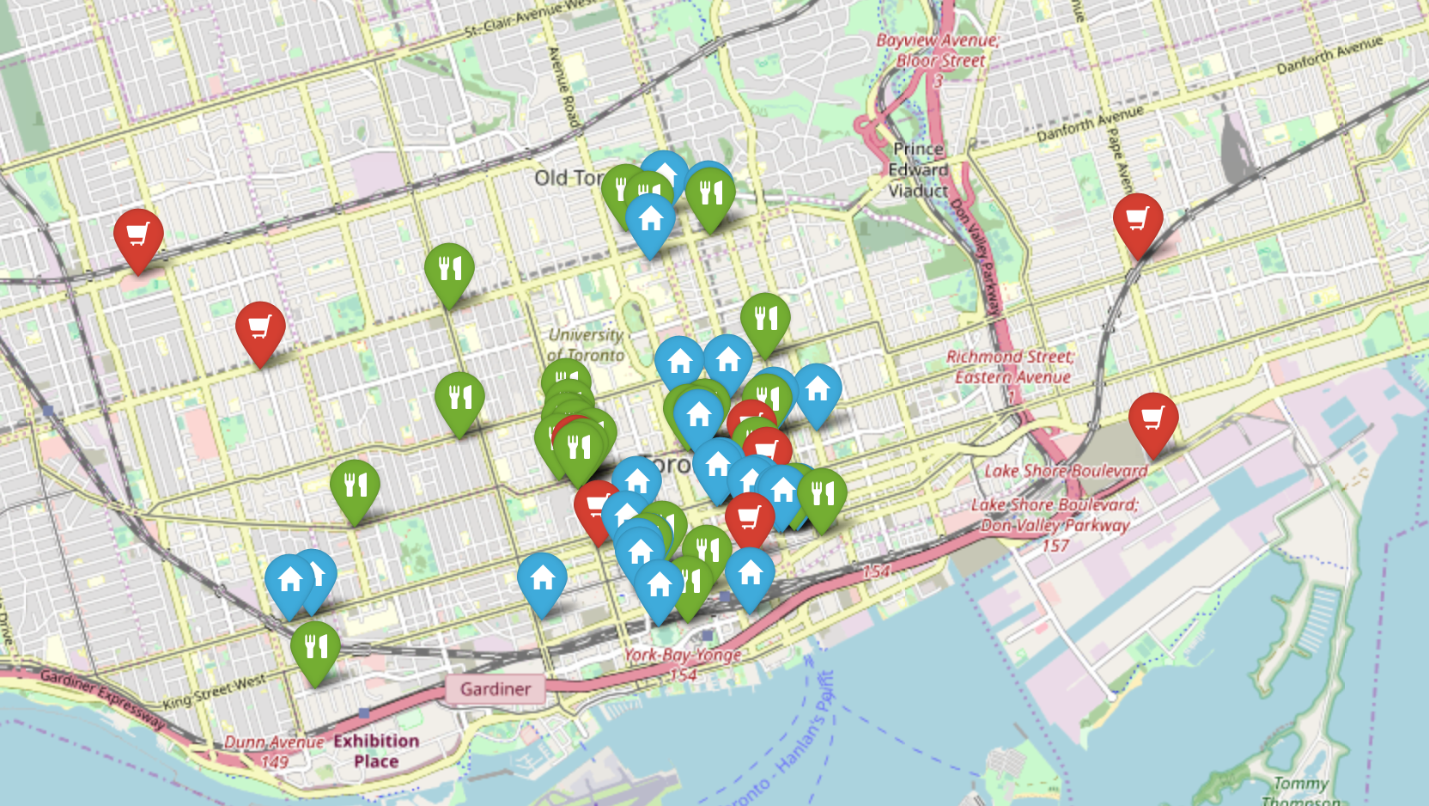
The Battle of Neighborhoods
Visualization…
Consolidated maps for all venues.

Slide 7
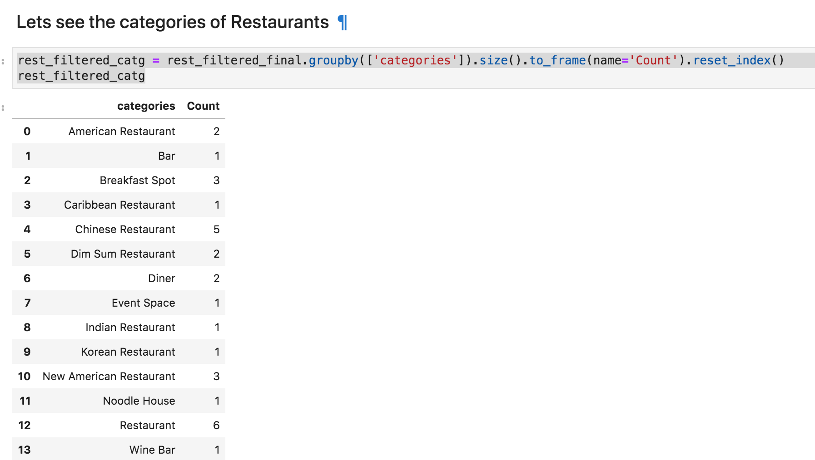
The Battle of Neighborhoods
Analyze the data
There are a total of 10 restaurants catering to Asian cuisine (Chinese, Indian, Korean, Dim Sum etc) as compared to 5 catering to American cuisine. This implies that there are many Asian inhabitants in the neighborhood or travellers from Asia visiting the neighborhood.

Slide 8
The Battle of Neighborhoods
Analyze the data…
The Shop map shows shops not interspersed like the Restaurants. Travellers would need to plan their shopping appropriately which is never good for a neighborhood and hence more sales would be made in the malls. Restaurants have enough variety of cuisine and travellers have plethora of options since the restaurants are fairly close to each other.
This is a proper business neighborhood with Hotels where one could spend time for meetings and use the restaurants for business lunches
There are very few stores competing with each other and there are distinct stores which reduces choices for travelers. We have 6 shopping malls indicating that people like to spend time in malls rather than individual stores. Malls may have similar stores within them.
Using the foursquare venue API, we could get data of remote neighborhoods like Toronto and help make plans for Event management companies and travelers.
We were able to analyze various categories of venues. More deep down analysis can be made and this was a great learning experience as a first time data science project

Slide 9
The Battle of Neighborhoods
Thank You!

